Slide 1
Implementation AND TESTING
CT026-3-1-Systems Analysis and Design

Slide 2
Topic Learning Outcomes
At the end of this topic, you should be able to:
1. Discuss benefits of coding standards
2. Discuss good programming practices

Slide 3
Contents & Structure
Implementation
Coding Standards
Principles of Good Programming

Slide 4
Key terms you must be able to use
If you have mastered this topic, you should be able to use the following terms correctly in your assignments and exams:
Coding best practices
Variable naming
Maintainable code
Bad smells
Refactoring

Slide 5
Recap From Last Lesson
Identify three (3) steps of the systems design phase?

Slide 6
Coding Standards
Code not only needs to do its job well, but must also be easy to add to, maintain and debug.
Needing to make changes to code could require a lot of energy to decipher lines of code that doesn’t make its purpose or intentions clear.
Neatly commented with details that explain any complicated constructs and the reasoning behind them.

Slide 7
Coding Standards
A coding standards document tells developers how they must write their code.
Avoid each developer coding in their own preferred style
Large project is coded in a consistent style
parts are not written differently by different programmers.

Slide 8
Why do we need coding standards?
Consistent look
Improve readability
Simplifies copying, editing and maintenance
Company wide standardization

Slide 9
Principles of Good Programming
KISS – Keep It Short and Simple
DRY - Don’t Repeat Yourself
Abstraction - Each significant piece of functionality in a program should be implemented in just one place in the source code
Open/Closed Principle - Software entities (classes, modules, functions, etc.) should be open for extension, but closed for modification.
don't write classes that people can modify, write classes that people can extend

Slide 10
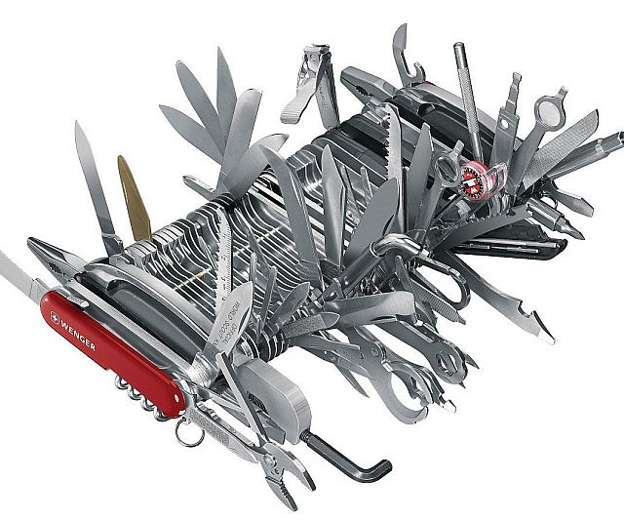
Principles of Good Programming
Single Responsibility Principle - A component of code (e.g. class or function) should perform a single well defined task.

Slide 11
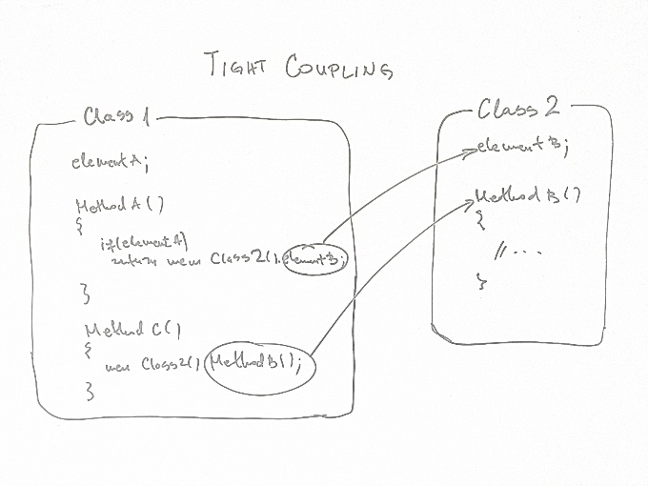
Principles of Good Programming
Minimize Coupling - Any section of code (code block, function, class, etc) should minimize the dependencies on other areas of code.
using shared variables as little as possible.
Maximize Cohesion - Code that has similar functionality should be found within the same component

Slide 12
Naming Conventions
No abbreviations
OnButtonClick vs OnBtnClk
Meaningful names
Intention revealing
int t; //Time to complete single lap
int singleLapTime;

Slide 13
Naming Conventions
Variable Names: Variable names should be in all lowercase, with words separated by an underscore, example: Incorrect:
$currentuser $currentUser
Correct:
$current_user
Names should be descriptive, but concise. We don't want huge sentences as our variable names, but typing an extra couple of characters is always better than wondering what exactly a certain variable is for.

Slide 14
Loop Indices
for ($i = 0; $i < $outer_size; $i++) { for ($j = 0; $j < $inner_size; $j++) { foo($i, $j); } }

Slide 15
Code Smells
Duplicated code
Large classes
Long methods
Long parameter list

Slide 16
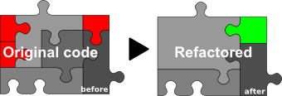
Refactoring
improve your software internal structure in a safe way while not changing / adding / removing behavior or external interfaces.
+readable code, +simplified code, +easier to change, +easier to add new value, +reduced redundancy, advices how to go on to keep-improve software, and last but not least +automatic tests.

Slide 17
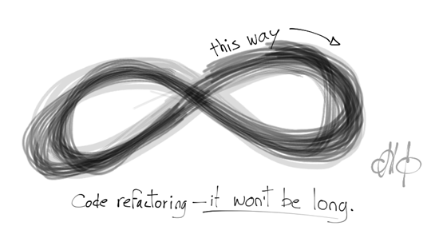
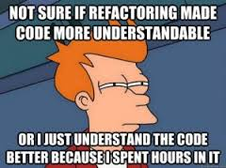

Slide 18
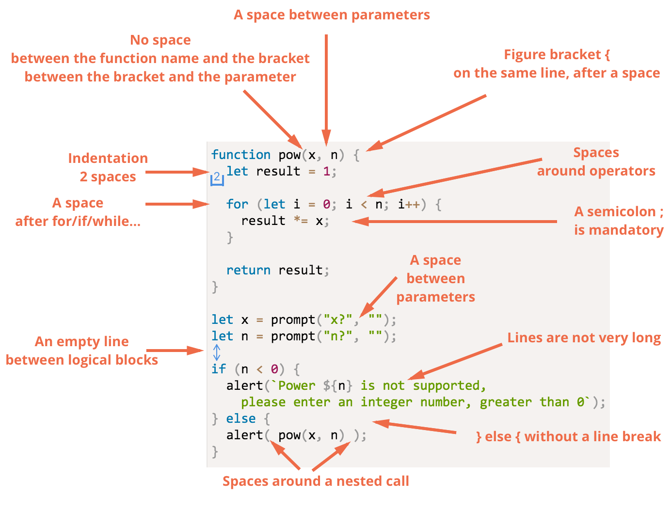

Slide 19
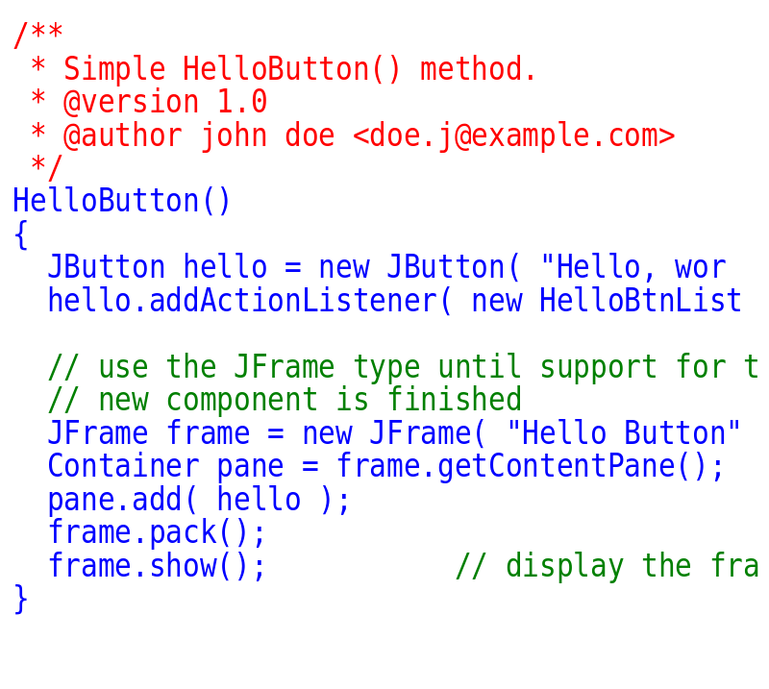

Slide 20
After the break
Implementation
Types of testing
Test plan

Slide 21
Topic & Structure of the lesson
Testing
Importance
Types of testing
Test Plan

Slide 22
Learning Outcomes
By the end of this lecture, YOU should be able to :
1. Discuss the importance of testing
2. Identify the types of testing
3. Prepare a test plan

Slide 23
Key Terms you must be able to use
If you have mastered this topic, you should be able to use the following terms correctly in your assignments and exams:
Unit testing
Integration testing
System testing

Slide 24
Software Testing
Testing is the process of exercising a program with the specific intent of finding errors prior to delivery to the end user.

Slide 25
Software Testing
Each program must tested to make sure it functions correctly
Desk checking : the process of reviewing the program code to spot logic errors, which produce incorrect result
Groups of three to five IT staff members participate in code review
Objective is to have a peer group identify errors, apply quality standards, and verify that the program meets the requirements of the system design specification

Slide 26
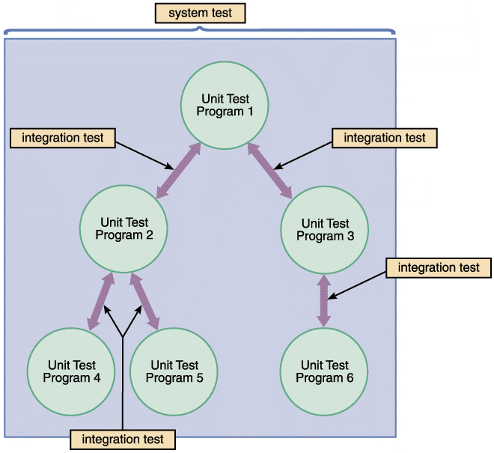
Types of testing
FIGURE 11-22 The first step in testing is unit testing, followed by integration testing, and then system testing

Slide 27
Types of testing
Unit Testing
The testing of an individual program or module
Objective is to identify and eliminate execution errors that could cause the program to terminate abnormally, and logic errors that could have been missed during desk checking
Test data should contain both correct data and erroneous data and should test all possible situations that could occur

Slide 28
Types of testing
Programs that interact with other programs and files are tested individually, before they are integrated into the system
Someone other than the programmer who wrote the program usually creates the test data and reviews the results

Slide 29
Types of testing
Integration Testing
Testing two or more programs that depend on each other to make sure that the programs work together properly
System Testing
Verify that all system components are integrated properly and that actual processing situations will be handled correctly
Confirm that the information system can handle predicted volumes of data in a timely and efficient manner

Slide 30
Types of testing
Verify that all system components are integrated properly and that actual processing situations will be handled correctly
Confirm that the information system can handle predicted volumes of data in a timely and efficient manner

Slide 31
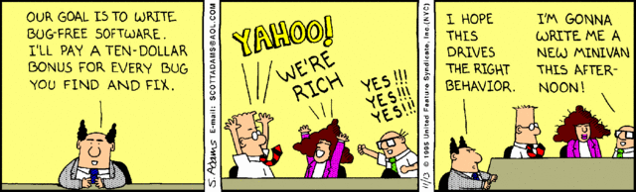
Test Plan
Used as a guide to test software.
Uses ‘dummy data’ (sample data)
Usually prepared before software is built
Prepared by ‘software testers’

Slide 32
Test Plan - Example
TEST DATE / TIME: |  |  | PROJECT ID:
TEST BY: |  |  | SYSTEM TITLE:
TEST CASE | TEST TYPE | TEST STEPS | EXPECTED RESULT | ACTUAL RESULT | REMARKS
1. User Sign-in | Unit Test | Open application Enter User Name as “X” and ……. | User successfully signed-in into the system, welcome page displayed. | Error – does not show error when ‘space’ is used in ID | Correction made to code to check ID validity.
2. Update User Profile

Slide 33
Test Case # | Test Unit | Test Procedures | Test Data | Expected Result | Actual Result | Status | Remarks
T023 | User Login | 1. Insert account email address. 2. Insert account password. 3. Click on “Login” button | Correct Input Data 1. Email Address: darrenseow9@gmail.com 2. Password: 121212 | Successfully Login into system. | Login is successful. | Success. | -
 |  | 1. Insert account email address. 2. Insert account password. 3. Click on “Login” button | Incorrect Input Data 1. Email Address: darren_332@gmail.com 2. Password: elabilab2u | Unable to login into the system and the error message is expected to be output. | Login failed and error message is displayed. | Success | -
T024 | Account Registration | 1. Insert user’s name 2. Insert email address. 3. Insert password. 4. Insert confirm password. 5. Click on “Create Account” button. | Correct Input Data 1. Name*: Lionel Massi 2. Email Address*: massi111@hotmail.com 3. Password*: massi1Q23 (*) Represent required field | Successfully registered new account. A verification email is expected to send to user’s email service. | New account is created without issue and verification email has been send. | Success | -
 |  | 1. Insert user’s name 2. Insert email address. 3. Insert password. 4. Insert confirm password. 5. Click on “Create Account” button. | Incorrect Input Data (Existing Email) 1. Name*: Lionel Massi 2. Email Address*: messi123@hotmail.com 3. Password*: massi1Q23 (*) Represent required field | Not successful registration due to the inserted email is belong to an account in the system. An error message will display to user and required user to insert a new email address. | Registration failed and error message is display. | Success | -

Slide 34
Summary
Testing
Importance
Types of testing

Slide 35
Question and Answer Session
Q & A

Slide 36
What To Expect Next Week
In Class
Preparation for Class
Maintenance
Maintenance tasks
Maintenance Management
Download the slide and study for the next chapter.

